Slide 1
FINAL PROJECT PRESENTATION

Slide 2
Food Storage Management System

Slide 3
Team Members
01
Jakiyatun Naima - 193902013
02
Mahbub Al Suprove Meshbah - 19392016

Slide 4
CONTENTS
01
Introduction
02
Budget
03
Diagrams
04
Testing
05
Conclusion

Slide 5
Introduction
A food store management system project aims to develop a comprehensive software solution to effectively manage various aspects of a food store's operations. The project typically involves the design, development and implementation of a system that streamlines processes, improves efficiency, and enhances customer service within the store.

Slide 6
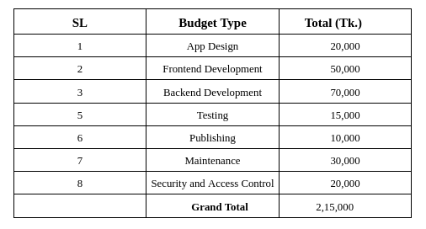
Budget

Slide 7
Diagrams

Slide 8
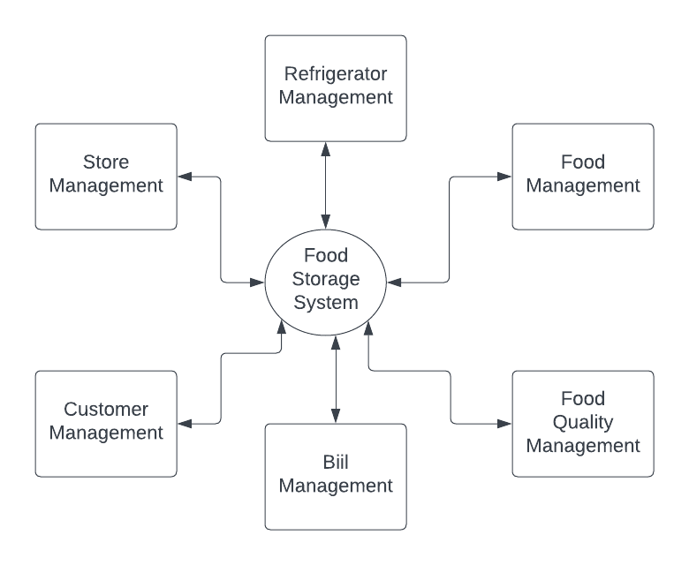
Zero Level DFD

Slide 9
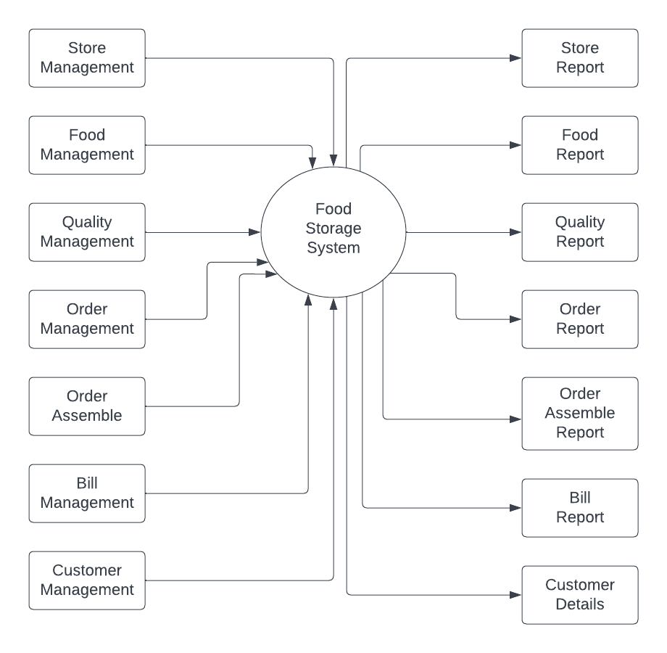
One Level DFD

Slide 10
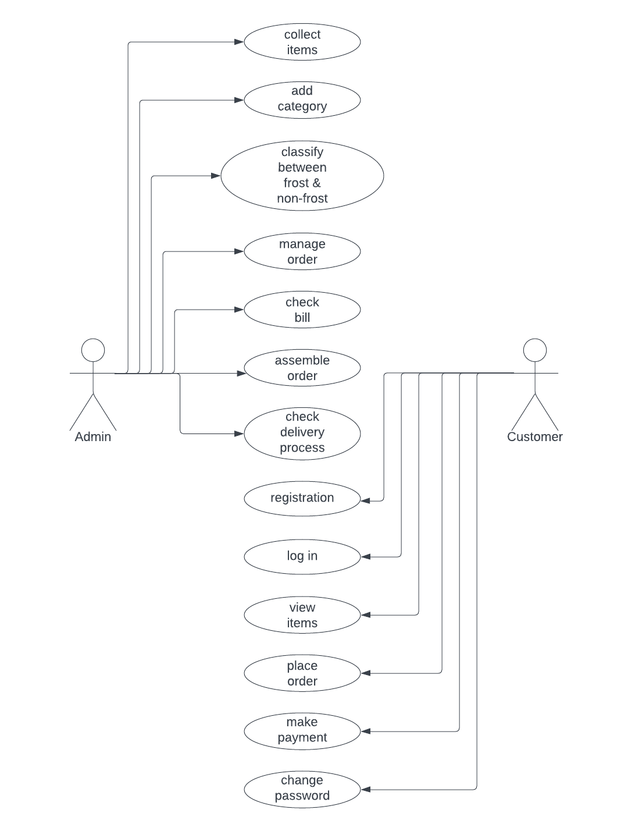
Use Case Diagram

Slide 11
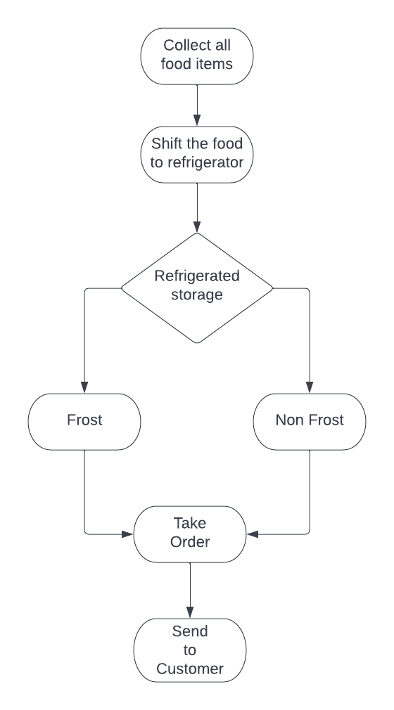
Block Diagram

Slide 12
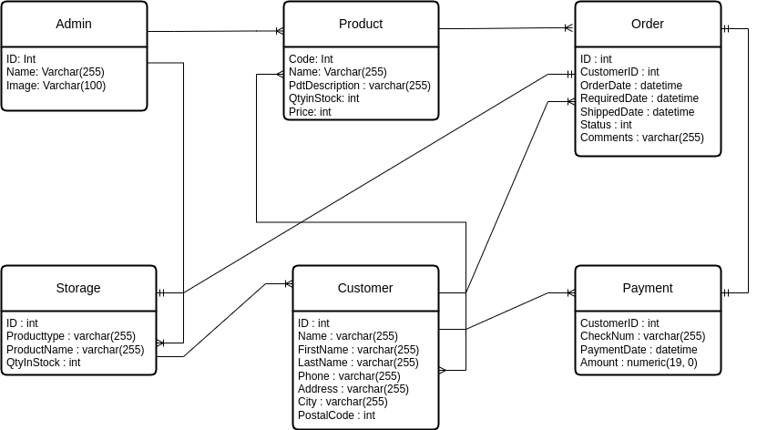
E-R Diagram

Slide 13
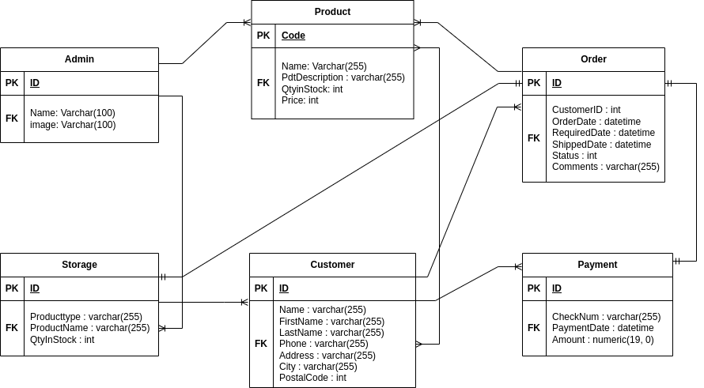
Database Design

Slide 14
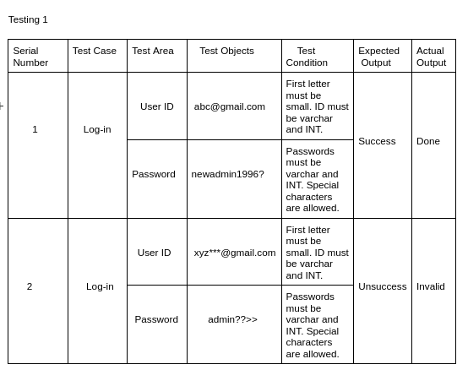
Testing

Slide 15
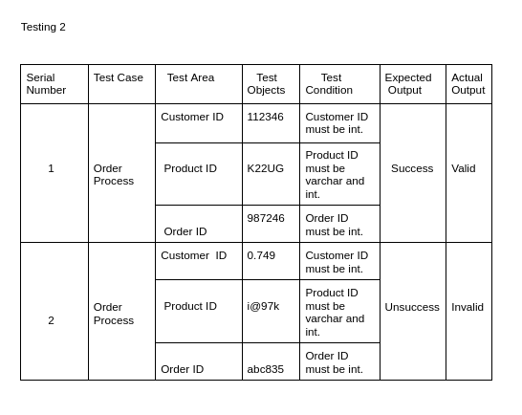
Testing

Slide 16
Conclusion
A food store management system is a crucial tool for food retailers to optimize their operations, enhance customer satisfaction and drive profitability. By automating and streamlining key processes such as inventory management, sales and order processing and customer management, the system enables food stores to operate more efficiently and effectively.

Slide 17

Any Questions?

Slide 18


